Slide 1

Team Creambears
Kang Hyun Woo / Kim Ji Seok / Hong Jae Min

Slide 2

Problem
Portal
It is hard to find looking articles in
KAIST Portal using its search engine

Slide 3





Design Goals
Image & Attached File Processing
Synonym Handling
Based on
Elasticsearch
New Search Engine For Portal Articles
Repeating
Events

Slide 4
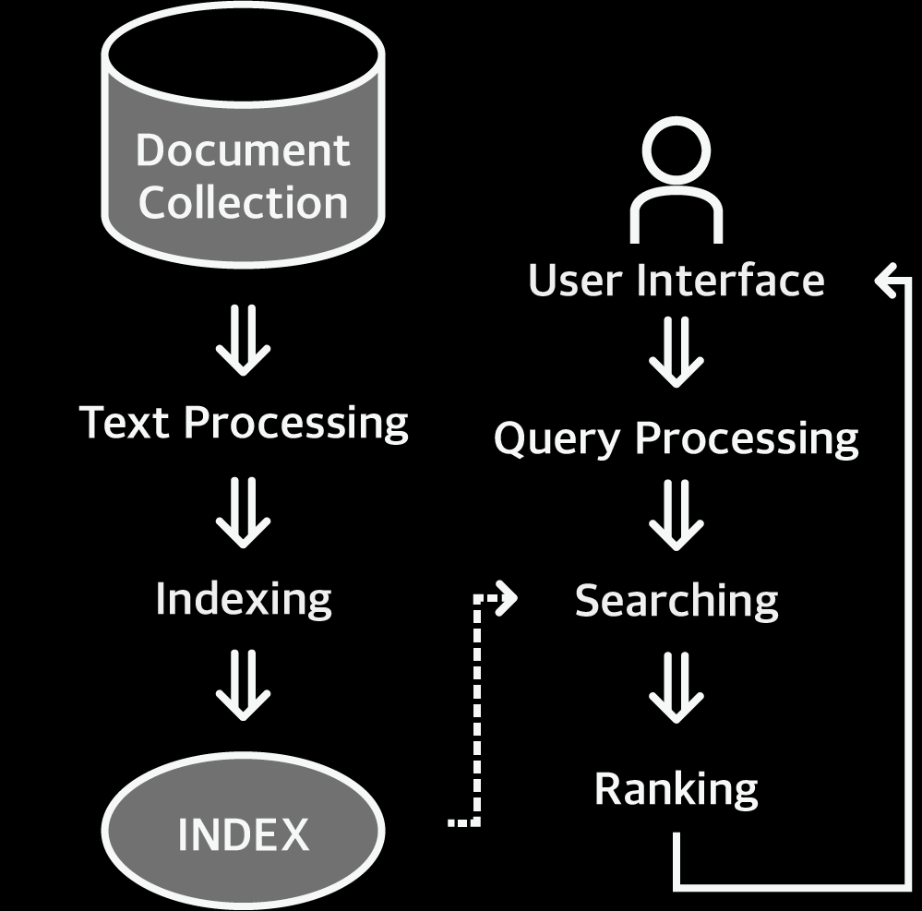
Design Goals

Slide 5
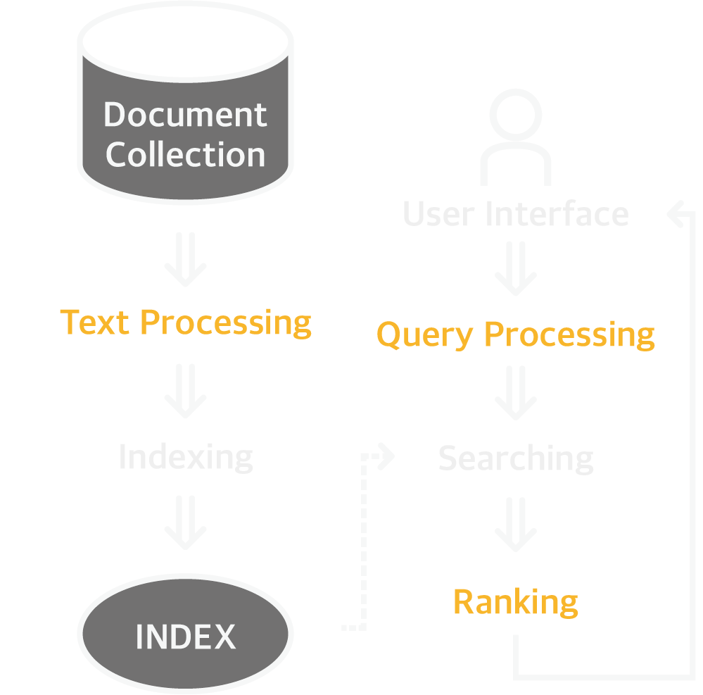
Design Goals
Extract text from images and attatched files
Handle synonyms of
unfamiliar official words
Considering
Uploaded dates & Hits

Slide 6





Implementation
- Text extraction
From Image
From Files
80
80
65
44
.hwp .doc .xls .ppt .zip
21
54
https://dataturks.com/blog/compare-image-text-recognition-apis.php

Slide 7
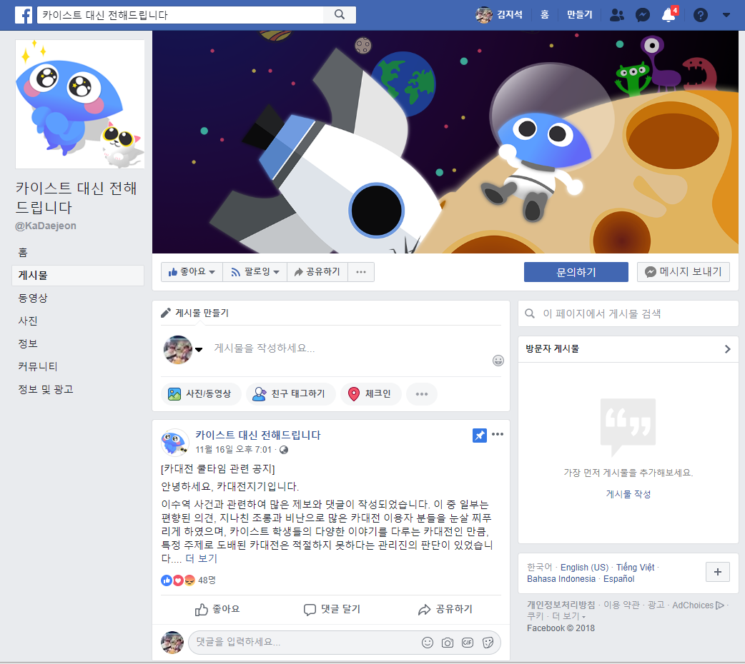
Implementation
- ＇카이스트 대신 전해드립니다＇ Crawling
Synonym handling
국장 국가장학금, 학자금
기숙사 생활관
카포전 학생대제전
Facebook page 카이스트 대신 전해드립니다
13,242 followers, 2,926 visits/day

Slide 8


Implementation
- Hits & Dates
Hits
One with more hits
gets a higher score
Date
More recent one
gets a higher score

Slide 9


Experiment Design
VS
Portal
VS

Slide 10

Experiment Design
- Questions
?
?
?
?
?
?
Image
Synonym
?
?
?
?
?
?
?
?
?
Repeating
Events
Important
Topics X2
3 Sets
X
5 Keywords
( 기숙사, 수강신청, 성적게시, etc. )

Slide 11
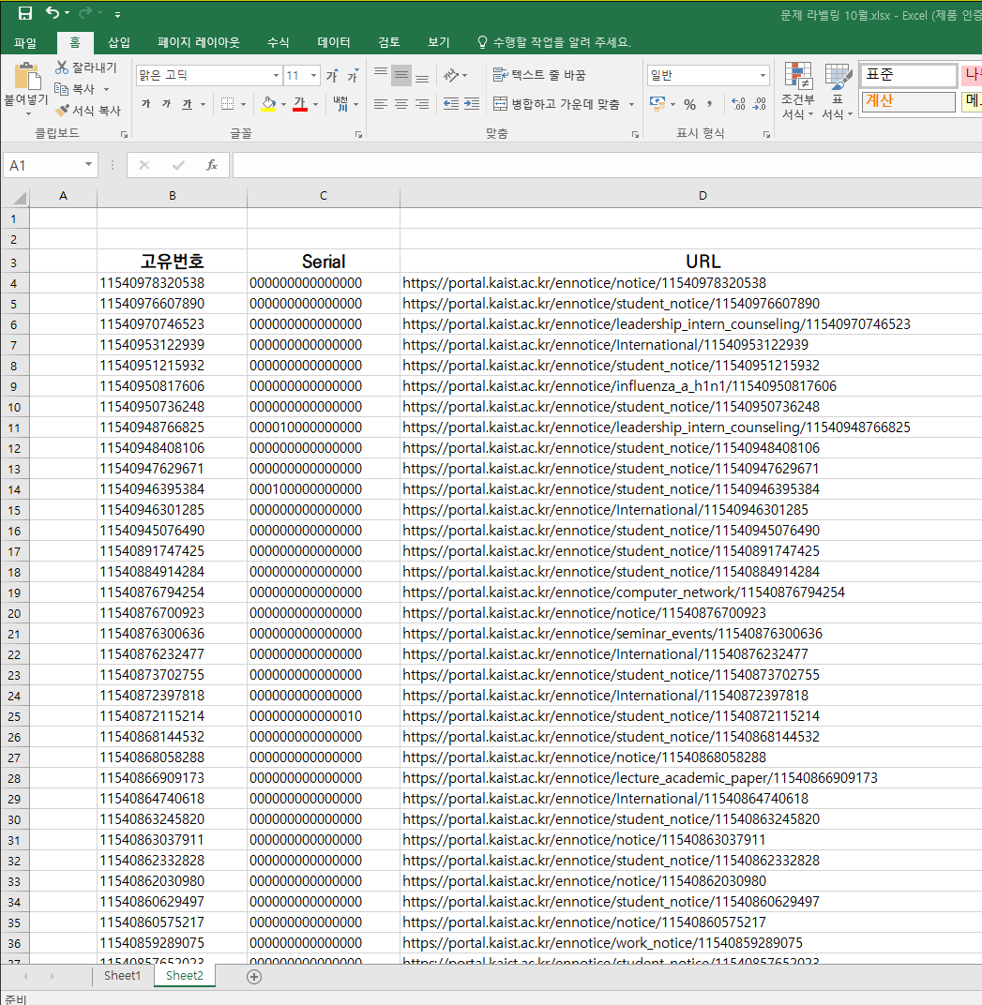
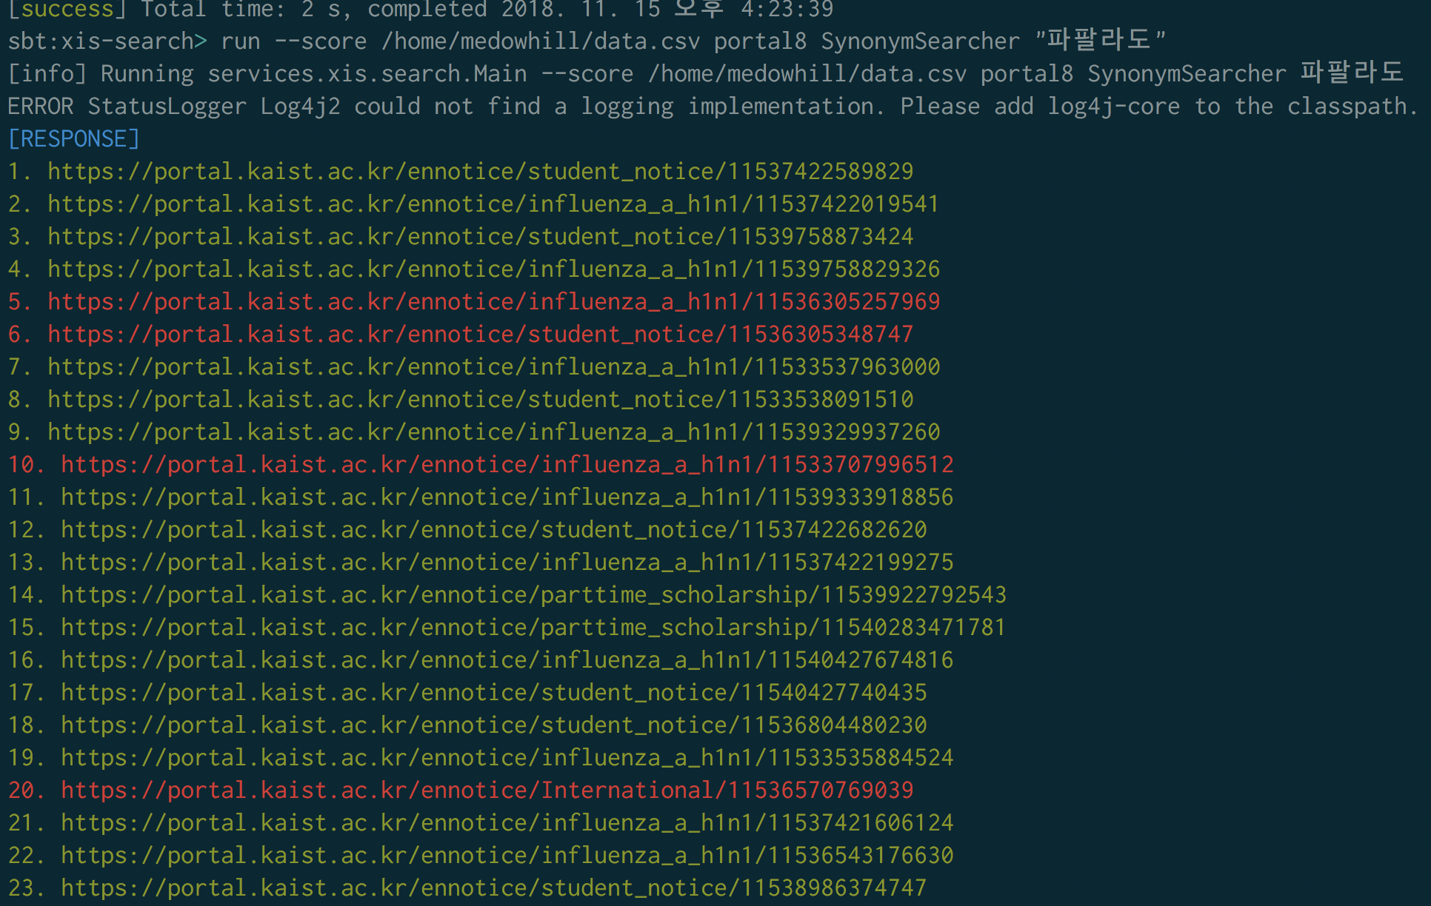
Experiment Design
- Offline Experiment
Lable 955 Portal articles
(August–October)
Automated average precision test

Slide 12



Experiment Design
- Online Experiment
?
?
?
?
?
?
?
?
?
?
?
?
?
?
?
?
?
?
?
?
?
?
?
?
?
?
?
?
?
?
?
?
?
?
?
?
?
?
?
?
?
?
?
?
?
3! X 3! = 36 Participants

Slide 13
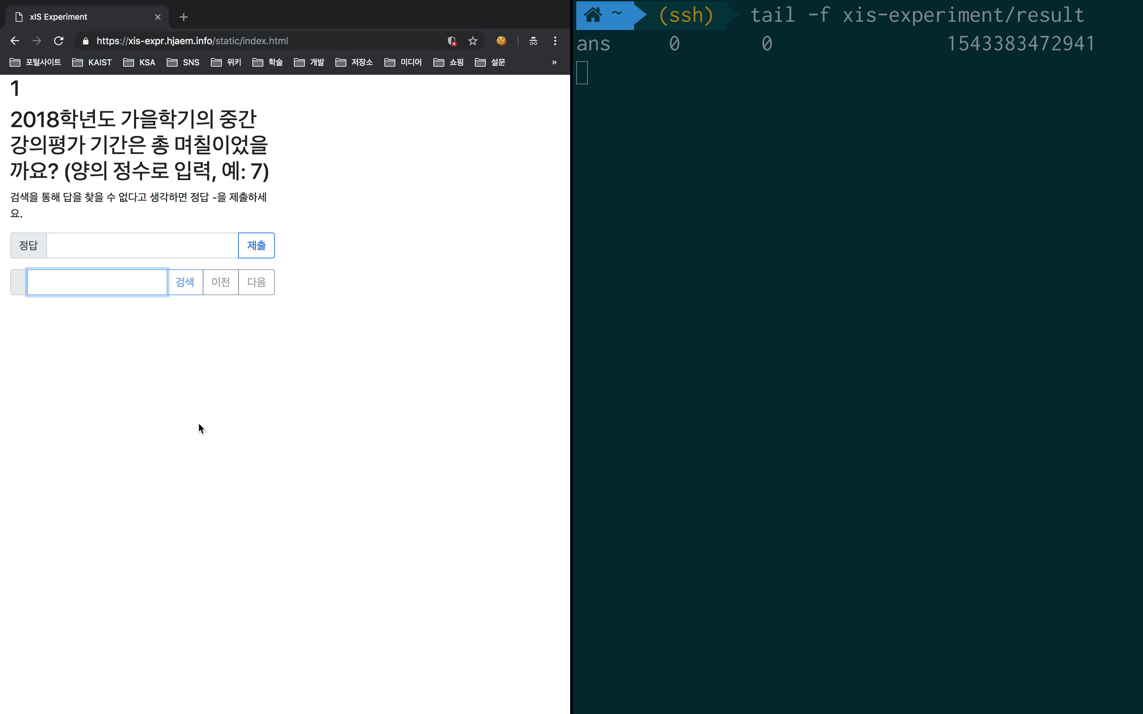
Experiment Design
- Log collecting

Slide 14



Result – Offline Experiment
- Average precision
Option1: Images + Attached Files
Option2: Synonym
Option3: Hits
Option4: Date

Slide 15



Result – Online Experiment
- Metrics
Correct Rate
Number of Searches
User’s Satisfaction

Slide 16
Result – Online Experiment
- Stastical techniques
Kruskal-Wallis test
H0: { Correct Rate, Number of Searches, Satisfaction } of Search engines have the same distribution
H0
Rejected
Mann-Whitney U test (Post-hoc test)
H0: xIS has worse {Correct Rate, Number of Searches, Satisfaction } than Portal/Elastic

Slide 17



Result – Online Experiment
- Stastical techniques
Image
Synonym
Repeating
Events
Important
Topics

Slide 18
Result – Correct Rate
Mann-Whitney U test
Kruskal-Wallis test
VS
VS
Image
p-value: 0.3710
p-value: <0.001 reject H0
Reject H0 with
p-value=1.08 x 10⁻⁶
Reject H0 with
p-value=1.08 x 10⁻⁶
Synonym
Repeating
Events
p-value: 1
Important
Topics
p-value: 1

Slide 19
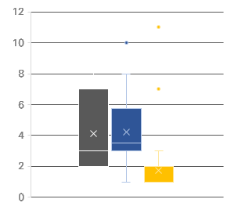
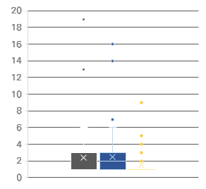
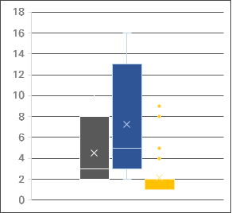
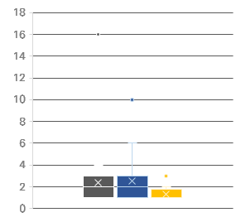
Result – Number of Searches
Portal
Elastic
xIS
Image
Synonym
Repeating
Events
Important
Topics

Slide 20
Result – Number of Searches
Mann-Whitney U test
Kruskal-Wallis test
VS
VS
Image
Reject H0 with
p-value=0.00760
Reject H0 with
p-value=3.48 x 10⁻⁴
p-value: <0.001 reject H0
Synonym
p-value: <0.001 reject H0
Reject H0 with
p-value=6.00 x 10⁻⁴
Reject H0 with
p-value=2.12 x 10⁻⁶
Repeating
Events
p-value: 0.004248 reject H0
Reject H0 with
p-value=0.0121
Reject H0 with
p-value=0.00356
Important
Topics
p-value: 0.003527 reject H0
Reject H0 with
p-value=0.0148
Reject H0 with
p-value=1.00 x 10⁻⁴

Slide 21
Result – Satisfaction
1
2
3
4
5

Slide 22
Result – Satisfaction
Kruskal-Wallis test
Mann-Whitney U test
VS
Rejects H0 with
p-value = 1.50 x 10⁻⁸
Rejects H0 with
p-value = 2.578 x 10⁻¹²
VS
Rejects H0 with
p-value = 2.30 x 10⁻¹⁰

Slide 23
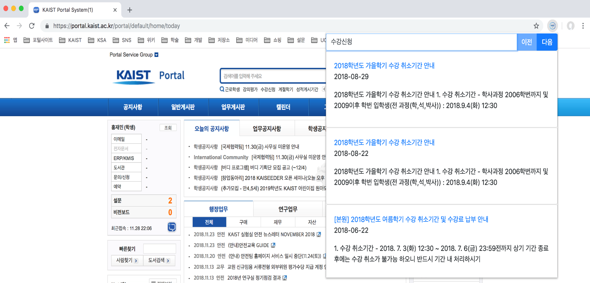
Live Demo
xIS Chrome extension is available at
bit.ly/xis-chrome-extension

